Slide 1
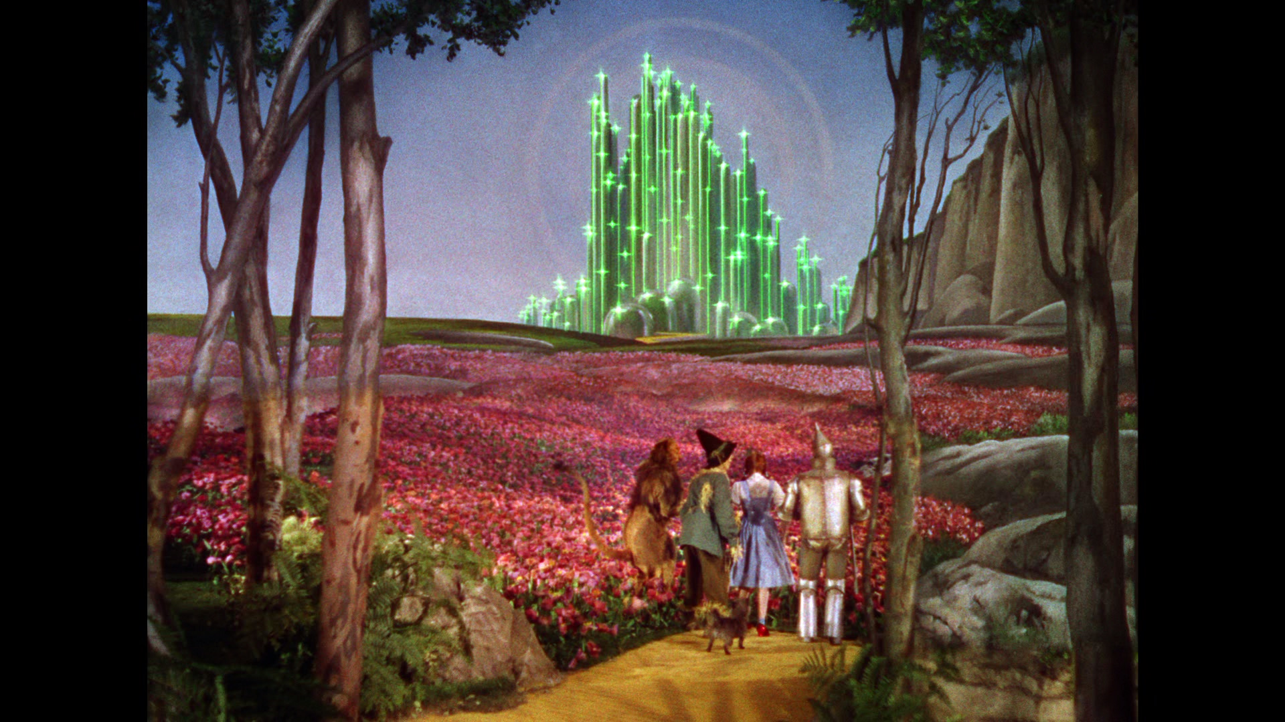
Modern Analog Technique, No-Analogs, Novelty
Toto, I don’t think we’re in Kansas anymore. – Dorothy
I know it when I see it – Justice Potter Stewart

Slide 2
Outline
Part I: Modern Analog Technique (MAT)
Conceptual Foundation
Dissimilarity Metrics
Environmental Inference
Part II: Complications with the MAT
Part III: No-Analogs & Novelty

Slide 3
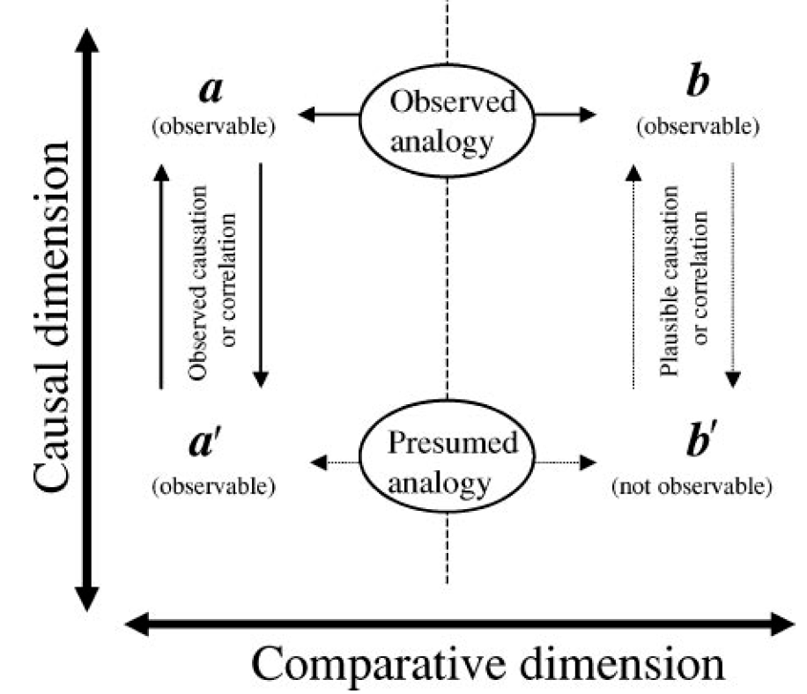
Reasoning by Analogy
SITE A
(PRESENT)
SITE B
(PAST)
POLLEN
VEGETATION
Jackson & Williams 2004 AREPS
Jackson and Williams, 2004 AREPS

Slide 4
Modern Analog Technique
Modern Pollen
Samples (S_{j})
Modern
Environments (E_{j})
Modern Analog Technique
1
Spruce
“Deciduous
Forest”
July T=24°C
powerpoint fig
Fossil Pollen
Sample i
Pine
Assumption: if the composition
Reason by analogy: If pollen sample A is similar in composition to pollen sample B, then they are likely to have been drawn from similar communities
Similarity
Oak
2
Spruce
Pine
Spruce
“Mixed
Forest”
July T=20°C
Oak
Pine
Oak
3
Spruce
“Boreal
Forest”
July T=16°C
Pine
Oak
Jackson and Williams, 2004 AREPS

Slide 5
Modern Analog Technique
Modern Pollen
Samples (S_{j})
Modern
Environments (E_{j})
Modern Analog Technique
1
Spruce
“Deciduous
Forest”
July T=24°C
D_{i1}=0.35
powerpoint fig
Fossil Pollen
Sample i
Pine
Assumption: if the composition
Reason by analogy: If pollen sample A is similar in composition to pollen sample B, then they are likely to have been drawn from similar communities
Similarity
Oak
2
Spruce
D_{i2}=0.40
Pine
Spruce
“Mixed
Forest”
July T=20°C
Oak
Pine
Oak
3
Spruce
“Boreal
Forest”
July T=16°C
D_{i3}=0.12
Pine
Oak
Jackson and Williams, 2004 AREPS

Slide 6
Modern Analog Technique
Modern Pollen
Samples (S_{j})
Modern
Environments (E_{j})
Modern Analog Technique
powerpoint fig
Fossil Pollen
Sample i
X
Assumption: if the composition
Reason by analogy: If pollen sample A is similar in composition to pollen sample B, then they are likely to have been drawn from similar communities
Similarity
Spruce
Pine
X
Oak
3
Spruce
“Boreal
Forest”
July T=16°C
Pine
Oak
Jackson and Williams, 2004 AREPS

Slide 7
Modern Analog Technique
Modern Pollen
Samples (S_{j})
Modern
Environments (E_{j})
Modern Analog Technique
powerpoint fig
Fossil Pollen
Sample i
X
Assumption: if the composition
Reason by analogy: If pollen sample A is similar in composition to pollen sample B, then they are likely to have been drawn from similar communities
Similarity
Spruce
Pine
X
Oak
“Boreal
Forest”
July T=16°C
3
Spruce
“Boreal
Forest”
July T=16°C
Pine
Oak
Jackson and Williams, 2004 AREPS

Slide 8
Modern Analog Technique
Modern Pollen
Samples (S_{j})
Modern
Environments (E_{j})
Modern Analog Technique
powerpoint fig
Fossil Pollen
Sample i
X
Assumption: if the composition
Reason by analogy: If pollen sample A is similar in composition to pollen sample B, then they are likely to have been drawn from similar communities
Similarity
Spruce
Pine
X
Oak
“Boreal
Forest”
July T=16°C
3
Spruce
“Boreal
Forest”
July T=16°C
Pine
Oak
Jackson and Williams, 2004 AREPS

Slide 9
Dissimilarity Metrics: Measuring Distances in Multivariate Space
Common Metrics
Euclidean
Standardized Euclidean
Squared Chord
Bray-Curtis
Mahalanobis
Pollen Type 2 (%)
Common Spaces
Geographic (Spatial)
Community
Climate/Environment
Trait
Pollen Type 1 (%)
=Fossil
sample i
=Modern
sample j
Notes:
Developed variant of modern analog technique for calibration
Level 1:
-match modern and fossil pollen samples
-close matches get assigned tree densities associated w/modern
-no matches=classic problem for analog approaches
-here, regroup into functional categories (e.g. spruce and fir regrouped to boreal conifers)
Level 2: rerun analysis
Level 3: regroup to very broad categories -- but didn’t work
Key point: allows finding of functional analogs when no compositional analogs exist

Slide 10
Euclidean Distance
a²+b²=c²
(x₂,y₂)
c
b
a=x₂-x₁
b=y₂-y₁
c=[(x₂-x₁)²+(y₂-y₁)²]^{0.5}
(x_{1,}y₁)
a
Euclidean Distance for
n dimensions:

Slide 11
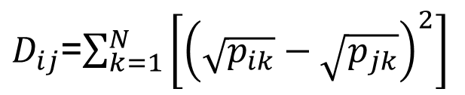
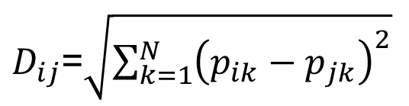
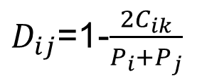
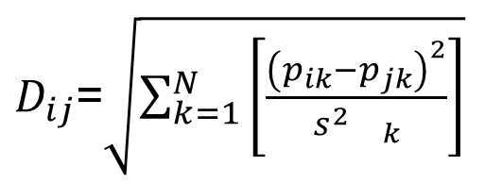
Distance Metrics, Characteristics, Applications
$D_{ij}$=$\sqrt{\sum_{k=1}^{N}{{\left(p_{ik}−p_{jk}\right)}^{2}}}$
Unweighted
Textbook Geometry
Euclidean
$D_{ij}$=$\sqrt{\sum_{k=1}^{N}{\left[\frac{{\left(p_{ik}−p_{jk}\right)}^{2}}{s_{}^{2}{}_{k}}\right]}}$
Standardized
Euclidean
Equal-Weight
Climate Data
Signal-to-Noise
Compositional Data
(abundances)
$D_{ij}$=$\sum_{k=1}^{N}{\left[{\left(\sqrt{p_{ik}}−\sqrt{p_{jk}}\right)}^{2}\right]}$
Squared Chord
$D_{ij}$=1-$\frac{2C_{ik}}{P_{i}+P_{j}}$
Compositional Data
(counts, presence/abs)
Bray-Curtis
i,j = indexes of samples in datasets P_{i}, P_{j}
k = index of variables N
s²_{k} = variance of variable k
C_{ik} = sum of all pollen of same type between datasets P_{i}, P_{j}

Slide 12
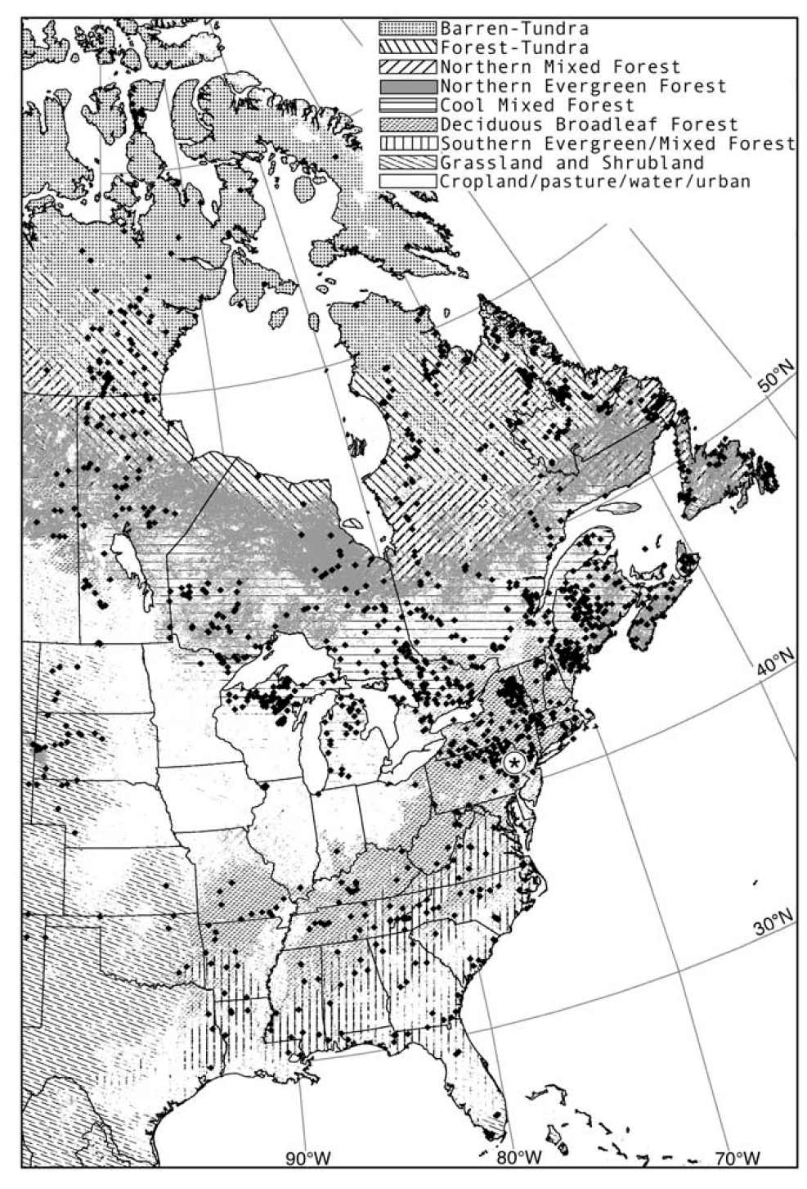
Which dissimilarity metric is the most discriminating?
Test: Assess ability of dissimilarity metrics to differentiate pairs of pollen samples drawn from same vegetation formation or from different formations
Gavin et al., 2003 Quaternary Research

Slide 13
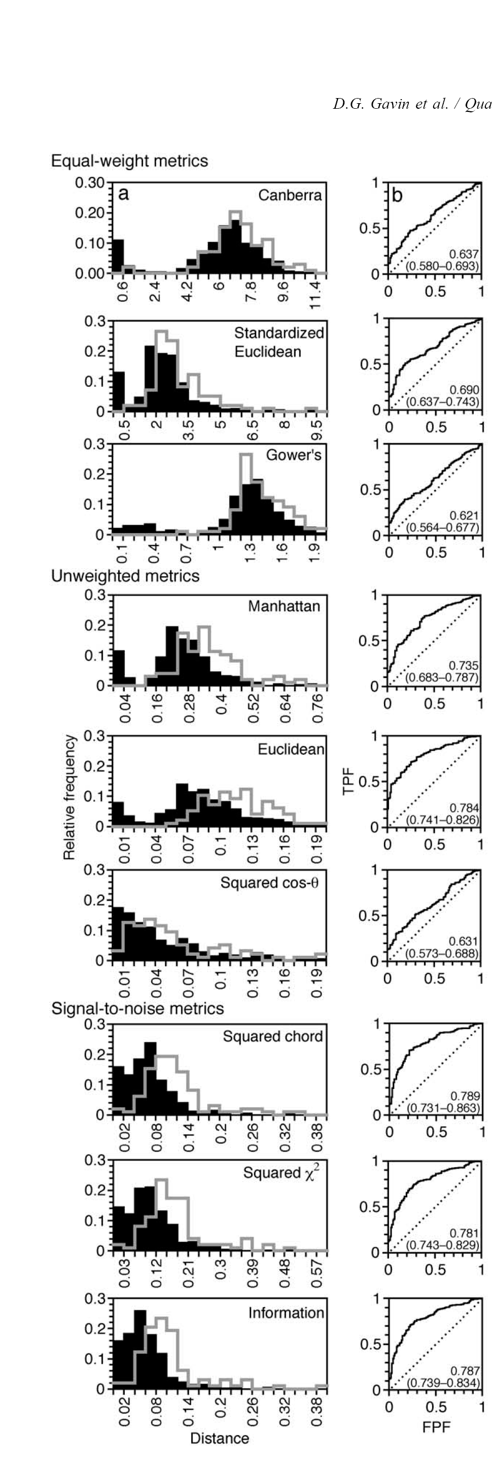

ROC (Receiver-Operating Characteristic) Analysis
A
AUC=0.631 to 0.784
AUC=0.621 to 0.690
AUC=0.781 to 789
Signal-to-noise metrics are the most discriminating
Squared-chord slightly better than other signal-to-noise metrics
Gray histograms: distances for same-biome pollen samples
Black histograms: distances for different-biome pollen samples
Gavin et al. 2003 QSR
Gavin et al., 2003 Quaternary Research

Slide 14
Dissimilarity Metrics -> Large Data Volumes
Correlation Matrix
(N x N)
Variables 1, 2, … N
PCA
Samples 1, 2, ….M
Dissimilarity Matrix
MAT
(M x M)
In most geo. datasets
M>>N
Notes:
Developed variant of modern analog technique for calibration
Level 1:
-match modern and fossil pollen samples
-close matches get assigned tree densities associated w/modern
-no matches=classic problem for analog approaches
-here, regroup into functional categories (e.g. spruce and fir regrouped to boreal conifers)
Level 2: rerun analysis
Level 3: regroup to very broad categories -- but didn’t work
Key point: allows finding of functional analogs when no compositional analogs exist

Slide 15
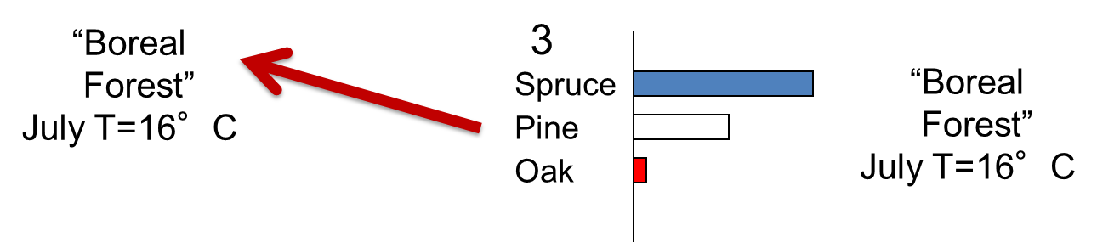
Modern Analog Technique: Key Steps and Parameters
Pollen Type 2 (%)
Calculate distances between i and all modern samples
Discard modern samples with D_{ij}>threshold (d)
Of remaining samples, keep N best analogs
Calculate average environmental variables from N
Assign average environmental values to sample i
Pollen Type 1 (%)
Notes:
Developed variant of modern analog technique for calibration
Level 1:
-match modern and fossil pollen samples
-close matches get assigned tree densities associated w/modern
-no matches=classic problem for analog approaches
-here, regroup into functional categories (e.g. spruce and fir regrouped to boreal conifers)
Level 2: rerun analysis
Level 3: regroup to very broad categories -- but didn’t work
Key point: allows finding of functional analogs when no compositional analogs exist

Slide 16
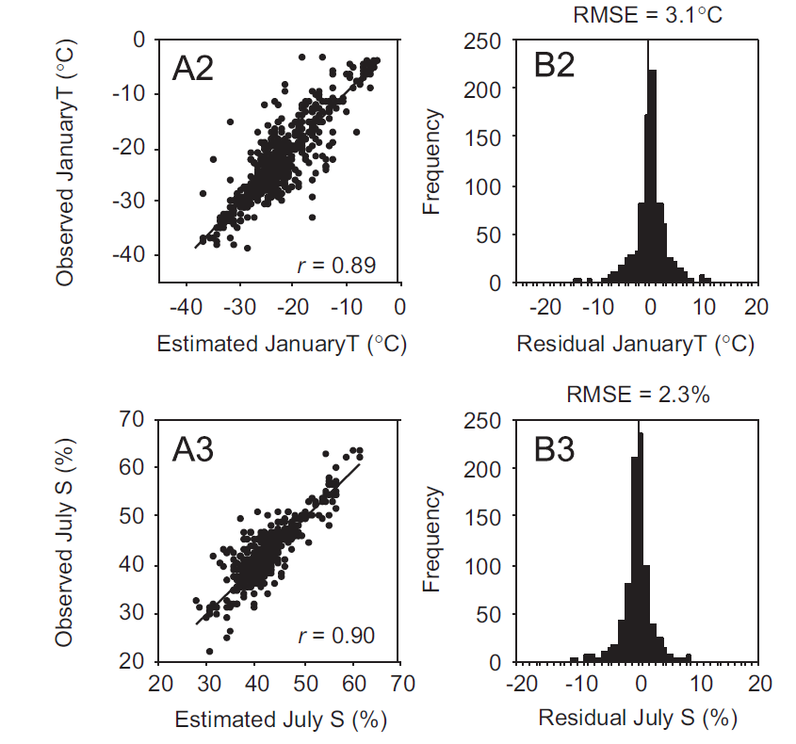
Cross-Validation: Leave-One-Out Technique
Frechette et al. 2008 QSR

Slide 17
Outline
Part I: Modern Analog Technique (MAT)
Conceptual Foundation
Dissimilarity Metrics
Environmental Inference
Part II: Complications with the MAT
Part III: No-Analogs & Novelty

Slide 18
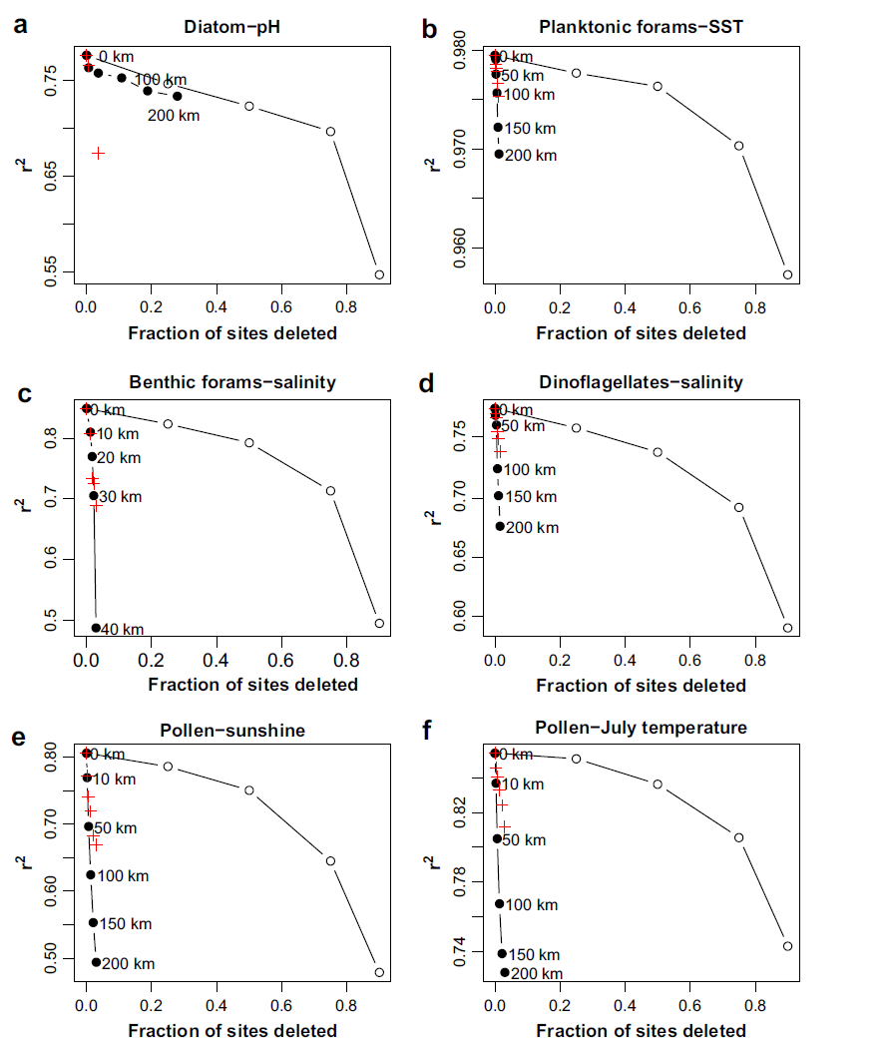
1. Spatial Autocorrelation: Leads to overestimates of explanatory power
Cross-Validation Tests
Sites deleted randomly
Closest sites deleted
Environmentally similar sites deleted
+
Significance Tests
(relative to random variable with spatial structure)
Telford and Birks 2009 QSR

Slide 19
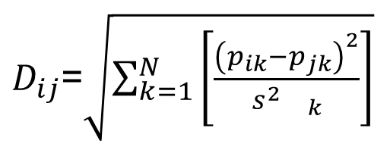
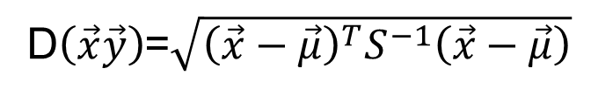
2. Correlations among variables
$D_{ij}$=$\sqrt{\sum_{k=1}^{N}{\left[\frac{{\left(p_{ik}−p_{jk}\right)}^{2}}{s_{}^{2}{}_{k}}\right]}}$
Covariance among variables leads to double-counting
Standardized
Euclidean
Mahalanobis downweights by covariance matrix
Mahalanobis
D$\left(\vec{x}\vec{y}\right)$=$\sqrt{{\left(\vec{x}−\vec{μ}\right)}^{T}S^{−1}\left(\vec{x}−\vec{μ}\right)}$
If there are no correlations among variables, Mahanobis reduces to Standardized Euclidean

Slide 20
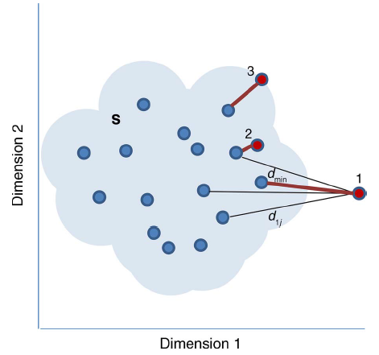
3. No Analogs: All modern samples are poor matches
Radeloff, Williams et al., 2015 Ecological Applications
Notes:
Developed variant of modern analog technique for calibration
Level 1:
-match modern and fossil pollen samples
-close matches get assigned tree densities associated w/modern
-no matches=classic problem for analog approaches
-here, regroup into functional categories (e.g. spruce and fir regrouped to boreal conifers)
Level 2: rerun analysis
Level 3: regroup to very broad categories -- but didn’t work
Key point: allows finding of functional analogs when no compositional analogs exist

Slide 21
Outline
Part I: Modern Analog Technique (MAT)
Conceptual Foundation
Dissimilarity Metrics
Environmental Inference
Part II: Complications with the MAT
Part III: No-Analogs & Novelty

Slide 22
No-Analog Definition:
No-Analogs: min(D_{ij})>D_{threshold}
No-analog communities consist of species that are extant today, but in combinations not found at present. “No-analog” is therefore shorthand for “no present analog.” …
No-analog fossil assemblages also have been called “disharmonious”, “mixed”, “intermingled”, “mosaic”, or “extraprovincial” assemblages (Graham 2005).
Text: Williams and Jackson 2007 Frontiers Ecology Environment
Fig: Radeloff, Williams et al., 2015 Ecological Applications

Slide 23
How to set D_{threshold}?
Set to D_{opt} from ROC analysis for same-biome vs different-biome pairs
Set to 99% percentile of all modern pairwise dissimilarities
Gavin et al., 2003 Quaternary Research

Slide 24
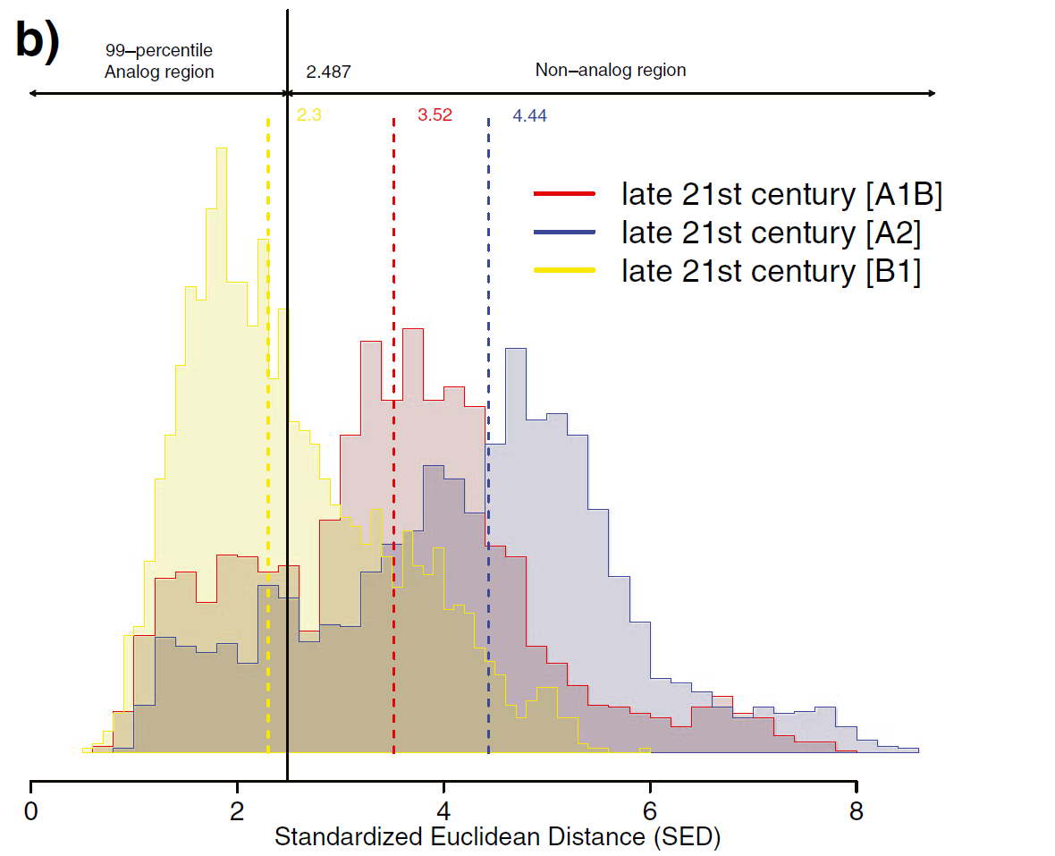
How to set D_{threshold}?
Set to Dopt from ROC analysis for same-biome vs different-biome pairs
Set to 99% percentile of all modern pairwise dissimilarities
Ordonez & Williams 2013
Climatic Change

Slide 25
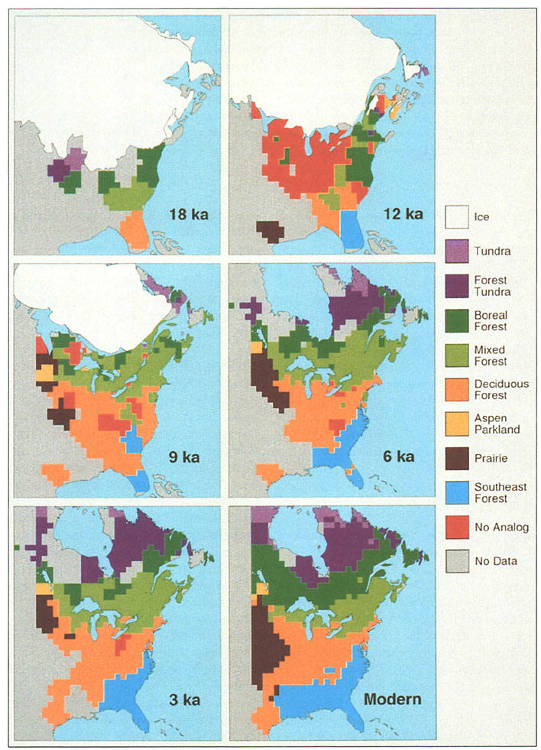
No-Analog Vegetation
Overpeck et al., 1992 Geology

Slide 26
Defining Novelty
Novelty = min(D_{ij})
Novelty is the degree of dissimilarity of a system, measured in one or more dimensions relative to a reference baseline, usually defined as the present or recent past.
General Considerations
Continuous, not categorical
Requires specifying variables (dimensions) for measuring novelty
Requires a reference baseline
Flexible – can apply to present/past/future
Radeloff, Williams et al. 2016 Ecol Apps

Slide 27
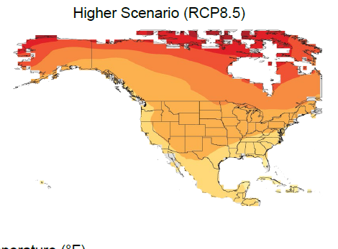
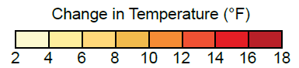
Magnitude, Rate, Novelty
MAGNITUDE
How much is a system changing?
RATE
How fast is a system changing?
NOVELTY
How novel is the new system state?
Magnitude (T₁-T₂)
US Fourth National Climate Assessment (NCA4), 2017

Slide 28
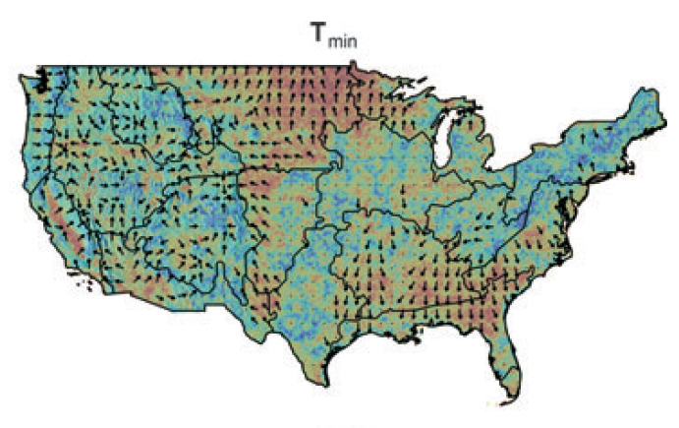
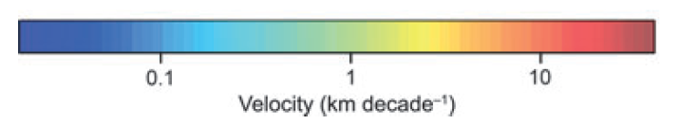
Magnitude, Rate, Novelty
MAGNITUDE
How much is a system changing?
RATE
How fast is a system changing?
NOVELTY
How novel is the new system state?
Rate (ºC/yr or km/yr)
Climate Velocities, T_{min}
Dobrowski et al. 2013, GCB

Slide 29
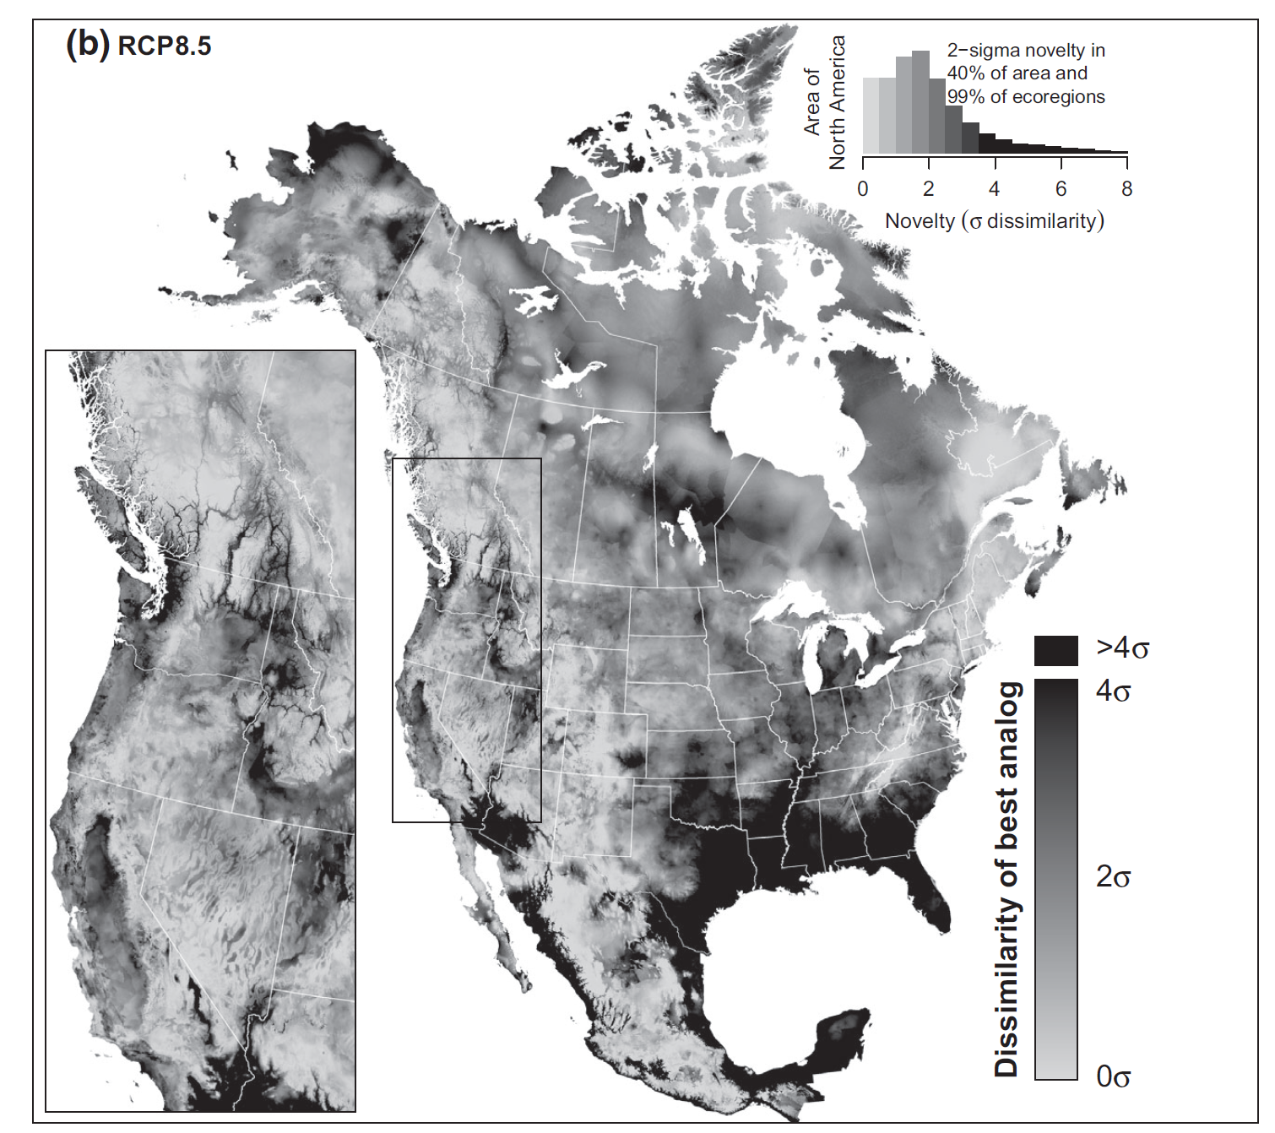
Magnitude, Rate, Novelty
MAGNITUDE
How much is a system changing?
RATE
How fast is a system changing?
NOVELTY
How novel is the new system state?
Climate Novelty of North America
2071-2100 vs. 1971-2000
Mahony et al., 2016

Slide 30
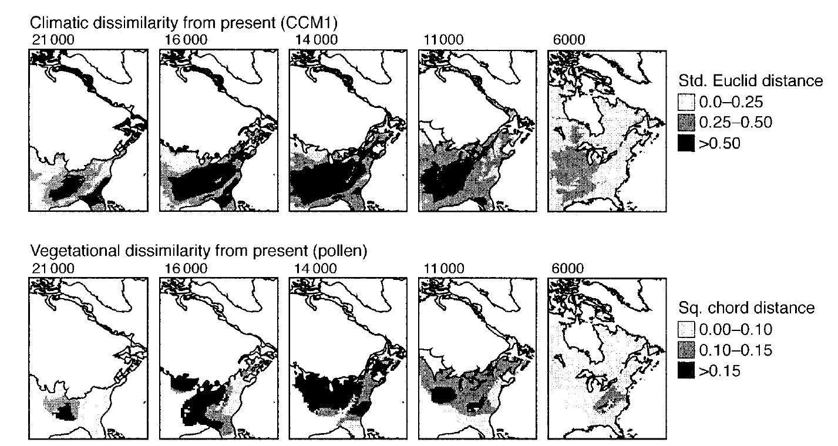
Mapping Novelty
Williams et al. 2001 Ecology

Slide 31
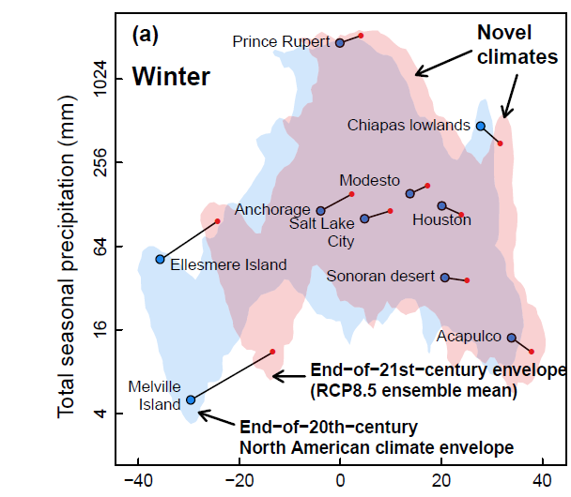
Mapping novelty
Colin Mahony Visit Apr 9-10!
Mahony et al., 2016

Slide 32
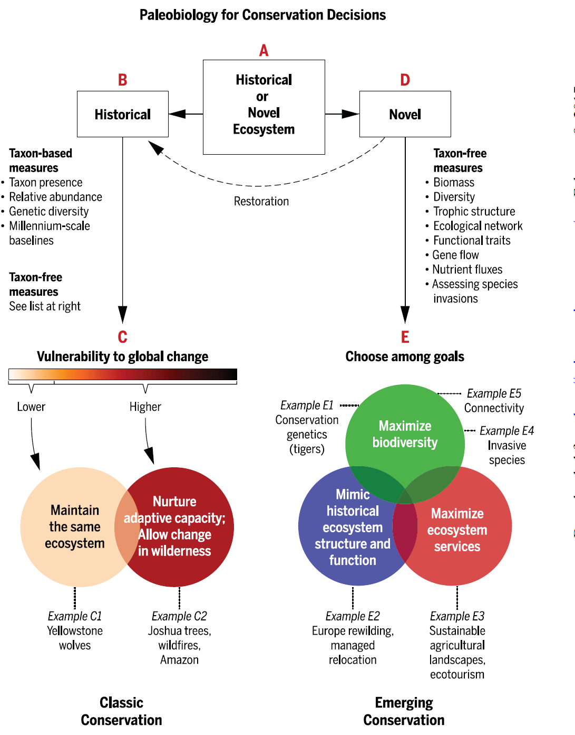
Why Novelty Matters: Conservation Decisions
Barnosky et al. 2017, Science

Slide 33
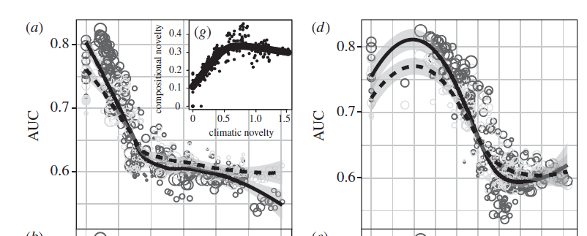
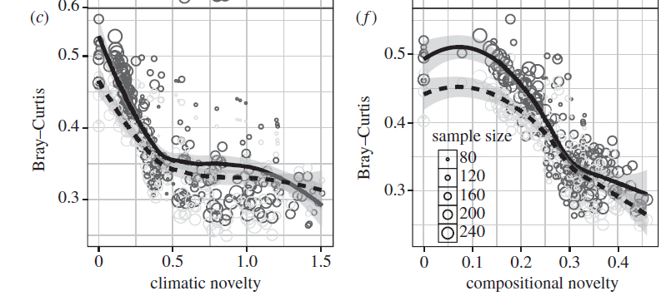
Why Novelty Matters: Ecological Forecasting
Predictive ability of species distribution models decreases as climate & community novelty increases
Maguire et al. 2016, Proc Roy Soc B

Slide 34
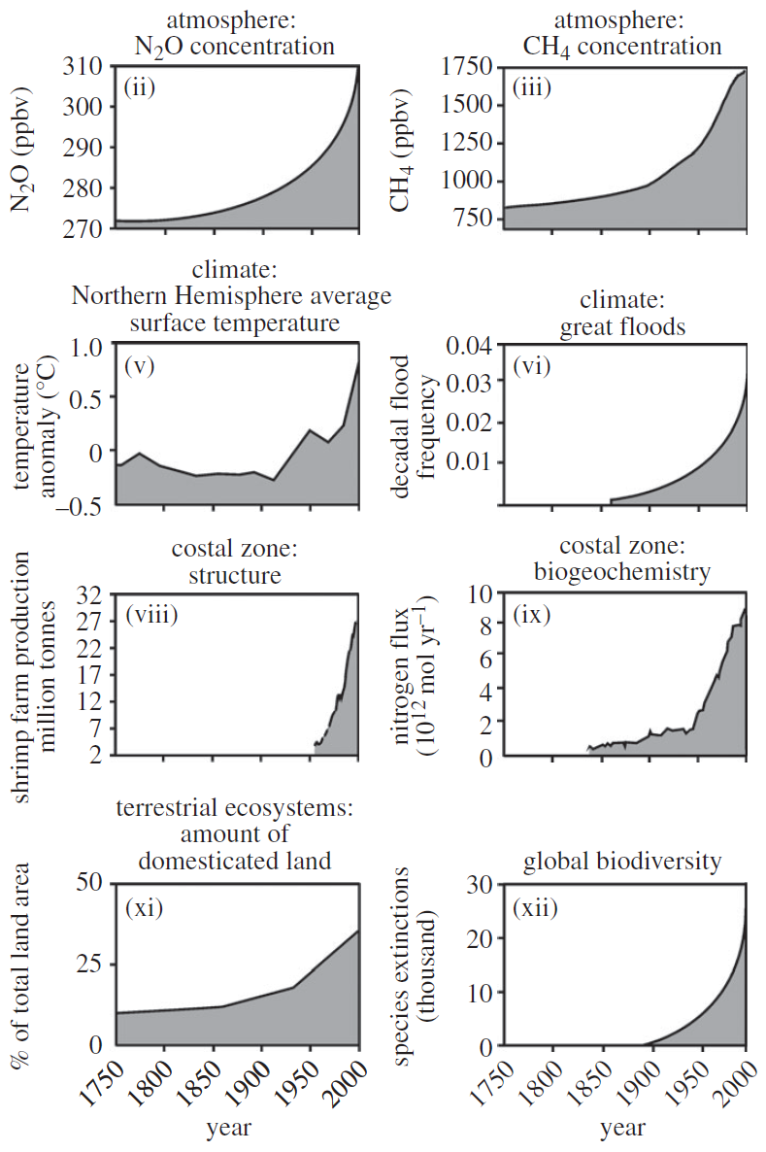
Last Thoughts: Why Novelty Matters: Updating our Language
We live in a dynamic world… but our language & conceptual frameworks are riddled with assumptions about static, equilibrial systems
Historical Baselines
Historic Ranges
Restoration
Resilience
Invasive Species
…. novelty helps us think about a world that is ever-changing, and ever-new

